Slide 1

Meeting the Requirements – what do we need to do?
Step 1
Ensure the second vaccine is administered by Friday 28th Jan.

Slide 2
Meeting the Requirements – what do we need to do?
Step 2
As soon as possible, download the NHS App (if you haven’t already).
As well as installing the Vaccination Pass on your son/daughter’s phone (in, for example, the iPhone ‘Wallet’), download and print two copies of the pdf Pass (Mr Worth will go over this in a moment).

Slide 3
Meeting the Requirements – what do we need to do?
Step 3
Fill in two copies of the official French SWORN document – one for your son/daughter to keep with them and one for us to keep.

Slide 4
Meeting the Requirements – what do we need to do?
Step 4
All pupils need to appear on a digital Passenger Locator Form for entry into Italy.
Pupils aged 17 and under will be added to staff forms, as staff are the ‘accompanying adults’.

Slide 5
Meeting the Requirements – what do we need to do?
Step 4
Pupils aged 18 will need to complete their own digital Passenger Locator Form. This will be completed in school time before the trip – you son/daughter should look for the notice of when and where this will happen.

Slide 6
Meeting the Requirements – what do we need to do?
Step 5
All pupils should complete a LFT on the morning of Friday 11th Feb before attending school.
All members of the ski trip will need to complete a Rapid Antigen Test at school the evening we travel, and register the result online.

Slide 7
Meeting the Requirements – what do we need to do?
Step 5
This needs to be done at school because we must ensure that we upload the results as near to our leaving time as possible – we then have 24 hours to get to Italy.
Mr March is overseeing this step and will issue separate information about it.

Slide 8
Downloading the COVID Pass

Slide 9
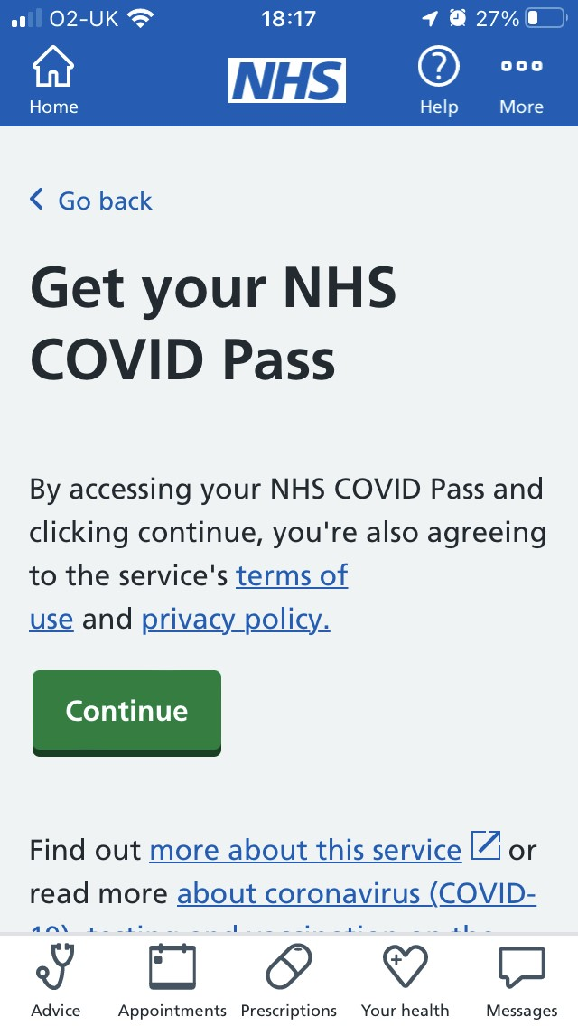
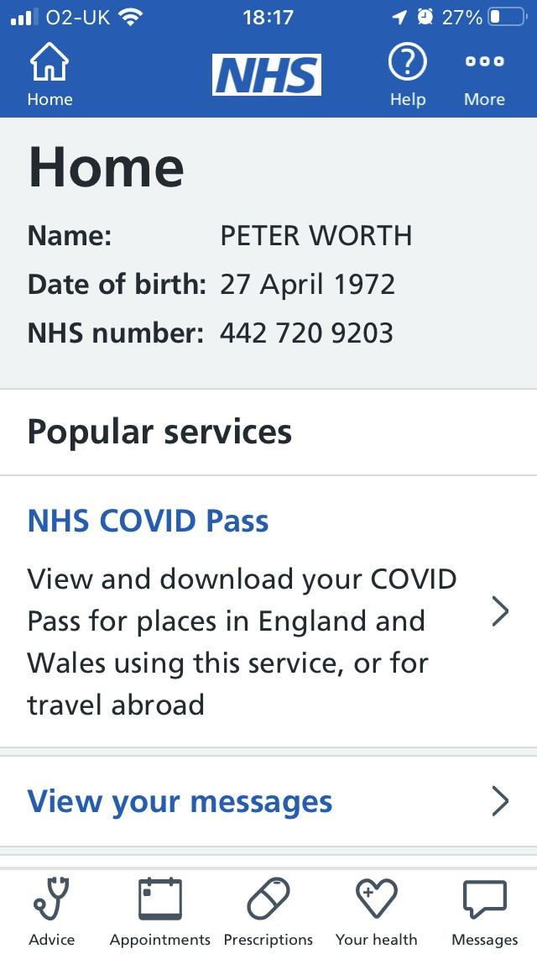
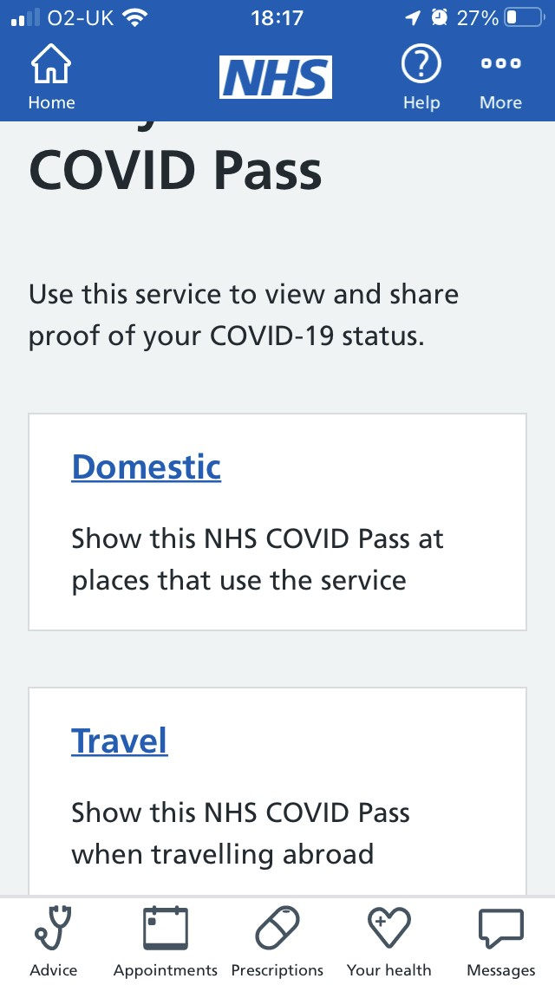

Slide 10
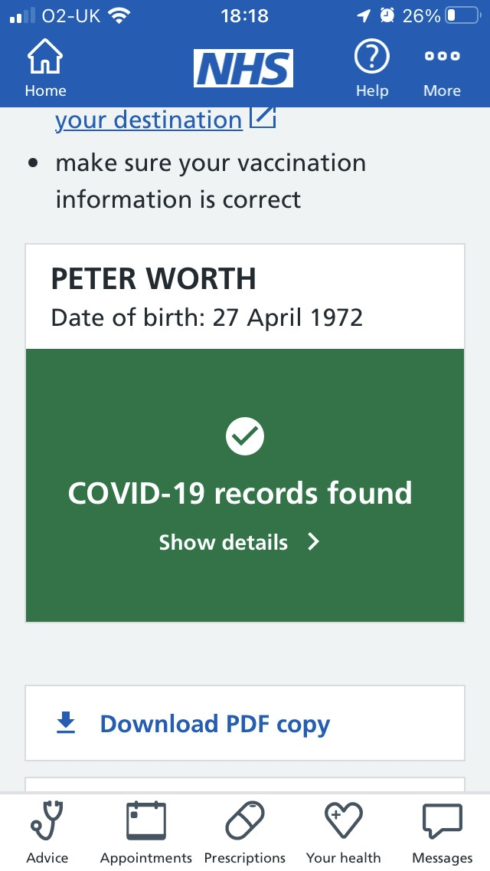
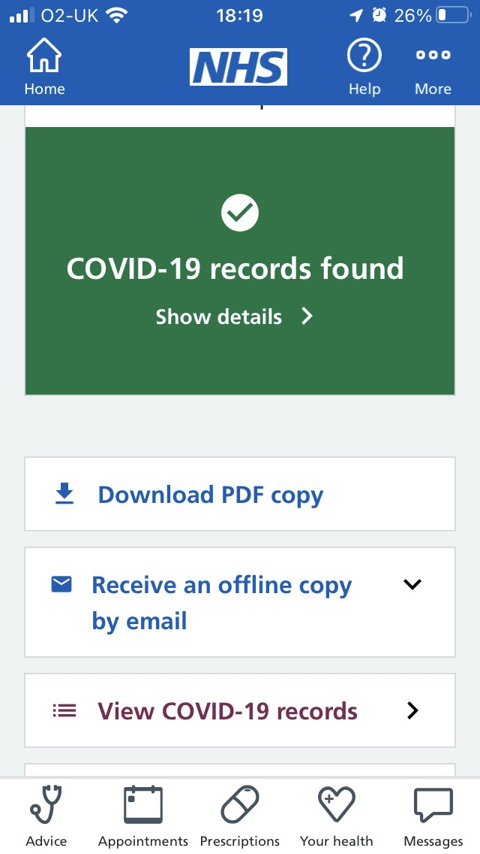
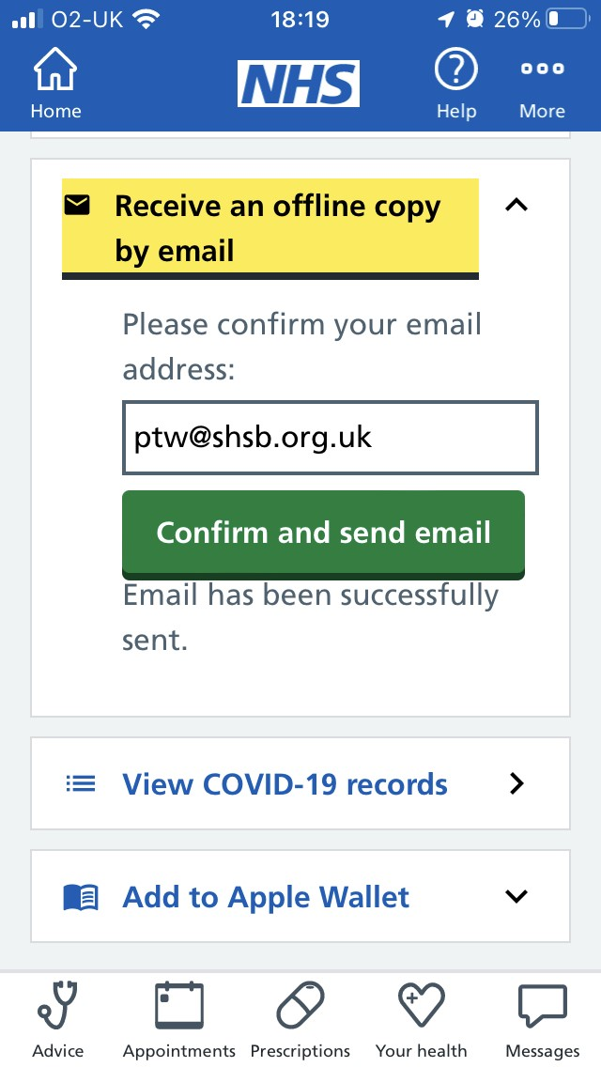

Slide 11
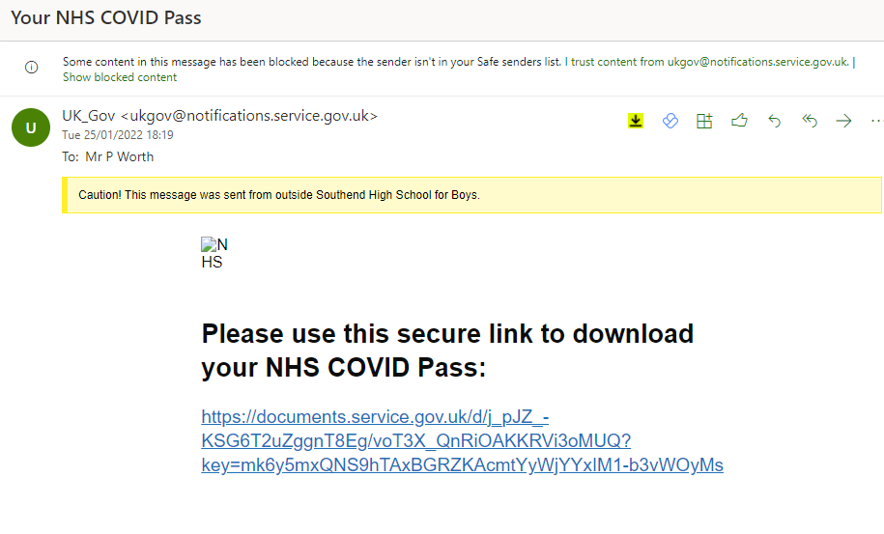

Slide 12
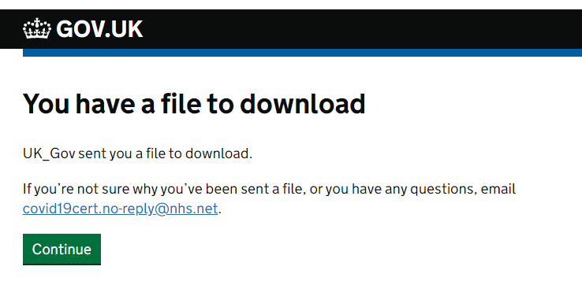

Slide 13


